Slide 1
Vision-Based Price Movement Classification from Candlestick Chart Images
A Data Science Project to Evaluate Vision-Only and Multi-Modal Models for Short-Horizon Directional Forecasting
Feb 7, 2026
Presented by Zicheng (Chance) Xu
Professor Iranitalab
Bellevue University
Winter Term
2025-2026

Slide 2
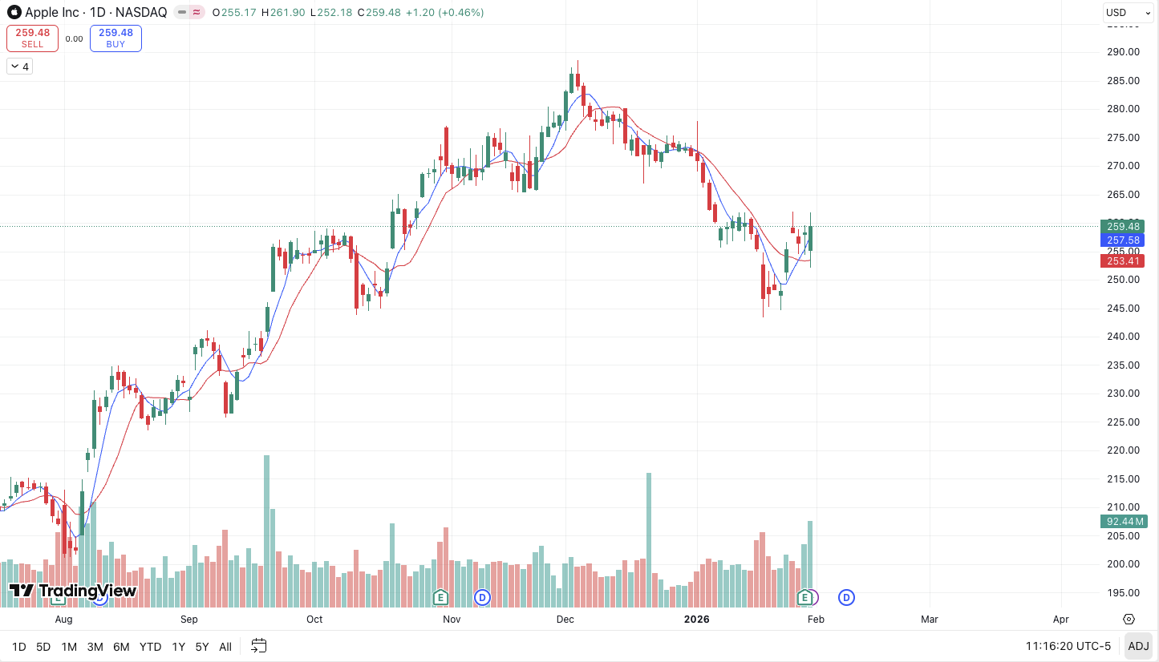
Business problem & why it matters
Traders often make fast decisions by looking at candlestick charts — but interpretations are subjective.
Question: can a model learn from a candlestick chart image and predict short-term movement?
Focus is NOT profitability; it’s a reproducible pipeline and honest out-of-sample evaluation.
Example candlestick chart (Apple Stock as of February 1, 2026; Source: TradingView.com)

Slide 3
Data
Assets: SPY, AAPL, MSFT, NVDA.
Frequency / span: Daily OHLCV, Jan 2015 – Dec 2025.
Source(Python): Stooq free CSV endpoint (download + local cache for reproducibility).
How we got the final sample size
                - Start with 11,064 daily rows across 4 tickers.
                - Labeling (triple-barrier).
                - Image generation.
                - Final usable dataset: 10,748 samples
                * Each sample = (ticker, date, label, 224×224 chart image, volume; + indicators for multi-modal tests).
                - Splits are time-based within each ticker to reduce look-ahead bias.

Slide 4
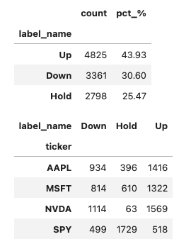
Labeling: Triple-Barrier (3 classes)
For each day t (entry = close), look forward 20 trading days.
Up: hits +5% first; Down: hits −5% first; Hold: neither by day 20.
Why this label: matches “up/down/no clear move” and avoids a single end-of-window return threshold.
Observation: class mix varies by ticker (e.g., SPY has more Hold; NVDA has fewer Hold).
Puerto Rico
Triple-barrier labels class balance

Slide 5
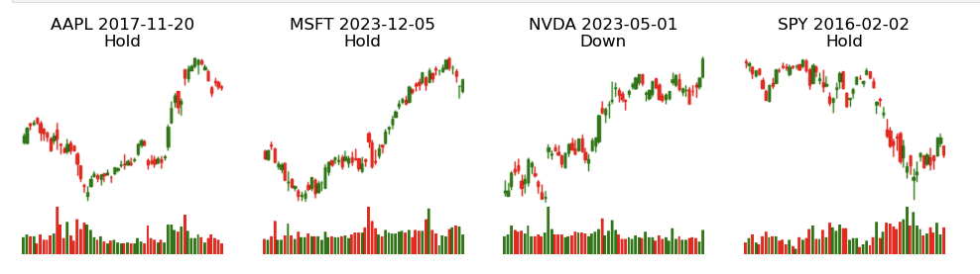
Image Inputs (Candlestick Windows)
One PNG per labeled date using a fixed lookback window (60 trading days).
Charts rendered consistently at 224×224 with a volume panel.
Axes and text removed to avoid “text leakage.”
Saved by ticker/date for reproducible joins (image_path).
Example candlestick chart images used as model inputs (224×224 with volume panel)
Puerto Rico

Slide 6
Modeling Approach
Model 1: Vision-only ResNet18 fine-tuned for 3 classes.
Model 2: Multi-modal fusion: ResNet18 image features + small MLP on numeric indicators.
Model 3: Alternative multi-modal: MACD + RSI + Bollinger indicators (more standard tech indicators).
Split: 70% train / 15% val / 15% test per ticker (time-based).
Metrics: accuracy, macro F1, confusion matrix
  - Macro F1 matters here because it treats Up/Down/Hold equally even if
  classes differ in size.
Puerto Rico

Slide 7
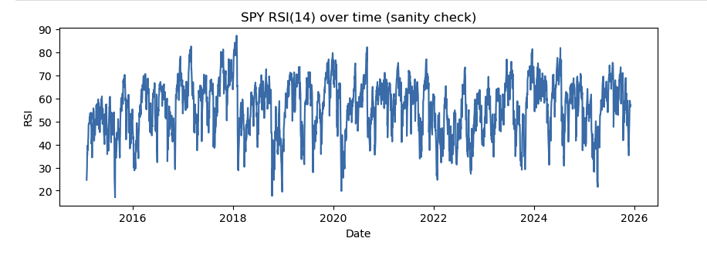
Numeric Indicators (Multi-Modal)
RSI(14): momentum score from 0–100 using Wilder-style smoothing.
MACD(12,26,9): EMA difference + signal + histogram (momentum shifts).
Bollinger(20,2σ): percent_b (position in band) + bandwidth (volatility proxy).
Standardization fit on training split only (avoid leakage).
Goal: test whether adding classic technical context helps generalization.
RSI(14) over time for SPY (sanity check for indicator calculation)
Puerto Rico

Slide 8
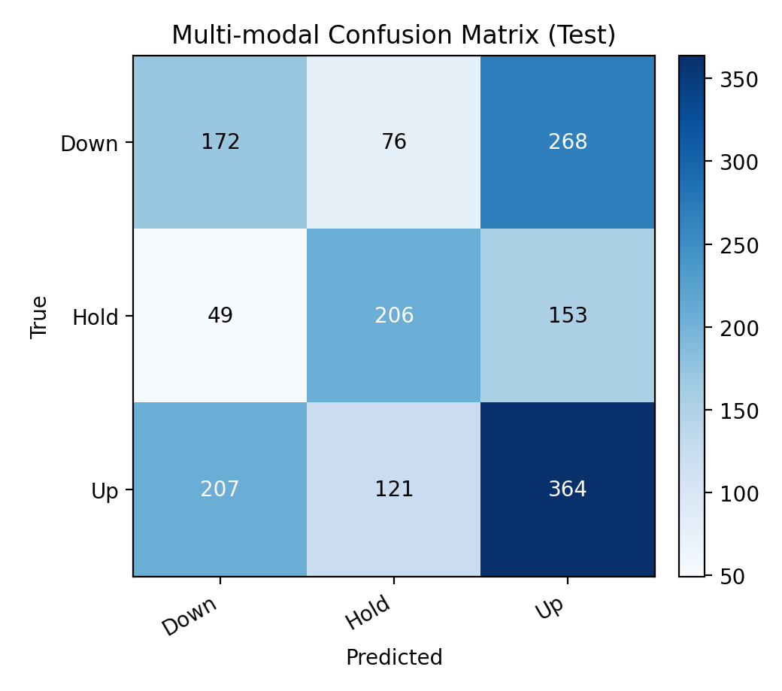
Results (Out-of-Sample)
Vision-only: training accuracy ~0.99 but validation best ~0.48 → overfitting.
Vision-only test: 0.452 accuracy, 0.447 macro F1.
Multi-modal (MACD+RSI+Bollinger) test: 0.459 accuracy, 0.455 macro F1.
Improvement over majority baseline (~0.439) is small → weak/unstable signal.
Biggest error: Down is often predicted as Up; Down has lowest recall.
Puerto Rico
Multi‑modal model (MACD+RSI+Bollinger) confusion matrix on the test split

Slide 9
Interpretation
Chart images alone did not provide strong predictive signal under this labeling setup.
Adding standard indicators only marginally improved performance.
Fixed ±5% barriers behave differently across assets (volatility differences) → label distribution shifts by ticker.
Main confusion is Up vs Down, which is the hardest part of direction prediction in noisy markets.
Takeaway: pipeline is valuable, but results are a “weak/negative finding” under current design choices.
Puerto Rico

Slide 10
Limitations & Ethical Considerations
Only 4 tickers → limited generalization across assets/regimes.
Fixed barriers ignore volatility → very different Hold rates (SPY vs NVDA).
Model overfits (high train acc; lower val/test).
This is research, not trading advice; avoid overstating performance.
Resource use: keep architecture lightweight and runs limited.
Puerto Rico

Slide 11
Future Work / Next Steps
Volatility-scaled barriers (e.g., based on recent realized volatility).
More tickers + more sectors to reduce overfitting to a few names.
Regularization & training tweaks: early stopping, weight decay tuning, augmentation.
More diagnostics: per-ticker metrics, time-slice performance, calibration checks.
Alternative targets: next-day direction, regression on returns, or probabilistic outputs.
Puerto Rico

Slide 12
Q&A examples (audience questions)
Why did you choose the triple-barrier labeling method instead of a simple up/down label?
Why was a 20-day horizon selected for labeling instead of a shorter time frame?
Why was a ±5% barrier used for labeling, given the volatility characteristics of the selected tickers?
Twenty trading days is roughly one month, which is long enough for a meaningful trend to develop and for a ±5% move to occur sometimes, but not so long that the label becomes disconnected from what the chart window represents. Shorter horizons (like 1–5 days) are dominated by noise and micro-events, which makes labels unstable and harder for a model to learn from images.
±5% is a practical, interpretable move size: big enough to avoid labeling tiny day-to-day fluctuations as “Up” or “Down,” but small enough to happen within a 20-day window often enough to produce signal. That said, the project results also show a limitation: the same fixed barrier behaves very differently across assets with different volatility. This is one reason future work could use volatility-adjusted (e.g., ATR- or σ-scaled) barriers.
A simple up/down label only checks whether the price is higher or lower after a fixed period, but it ignores how price moved in between. Triple-barrier labeling is closer to trading reality: it distinguishes between (1) hitting an upside move, (2) hitting a downside move, or (3) doing neither within the horizon (“Hold”). That reduces “label noise” where prices briefly move strongly one way, then reverse by the end of the horizon. It also gives a cleaner definition of outcomes that better matches risk-managed decision-making.
Company Name
Quarter Month
Year

